Slide 1

Class Curriculum Information
CLASS NOTICES
Class Text
Our class text is When We Were Warriors by Emma Carroll.
Trip
To help support our understanding of World War 2, Year 6 pupils will be going to Holdenby House on Tuesday, 21st October 2025. Please ensure your child has warm clothing, suitable footwear and a warm, waterproof coat.
Reading
All children will read for at least 10 minutes every day in school and we hope parents will do the same at home. Books will be changed when children have completed an Accelerated Reading Quiz.
PE
PE will take place on a Wednesday and Friday. Children can come to school in their kit on PE days (shorts/leggings/jogging bottoms, plain t-shirt, trainers and jumper for outdoors).
Homework
Spellings and maths will be sent out every Friday and returned back into school by the Wednesday.
Please ensure your child brings in a water bottle, school jumper/cardigan and coat everyday.
Year 6
Autumn Term 1
2025/2026

Slide 2




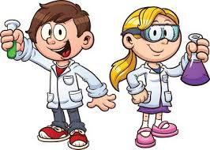


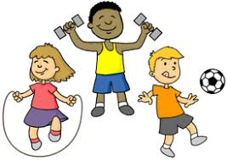
ENRICHMENT AREAS OF LEARNING
ENRICHMENT AREAS OF LEARNING
English | In English this term we will be focusing on retrieval, vocabulary and inference skills when answering questions linked to our class text, images and extracts. Our writing will focus on dialogue, narrative and poetry.
Maths | In Maths, we will be learning about place value and calculating using the four operations (+ - x and ÷) If your child is still unsure of their times table facts, please encourage them to practise regularly at home. This will support your child working multiplication and division of larger numbers.
Science | During the term, the children will be learning about electricity, understanding how to record electrical circuits using scientific symbols and conducting experiments to give the children a chance to spot patterns and carry out controlled investigations.
Computing | In this unit, children will
History | Our main focus for this half term is World War II. We will study this period from a child’s perspective, looking at evacuation and rationing. Our studies will allow us to investigate the impact of war on different countries and communities.
R.E. | In RE this term, we will be focusing on Christianity and discussing what matters most to Christians and to Humanists?
DT | During this term, we will focus on DT in our unit about automaton. We will use available materials and careful measurements to make and join moving parts to a frame and evaluate how well they work
P.E. | Our PE will focus on hockey and football this half term.

