Slide 1

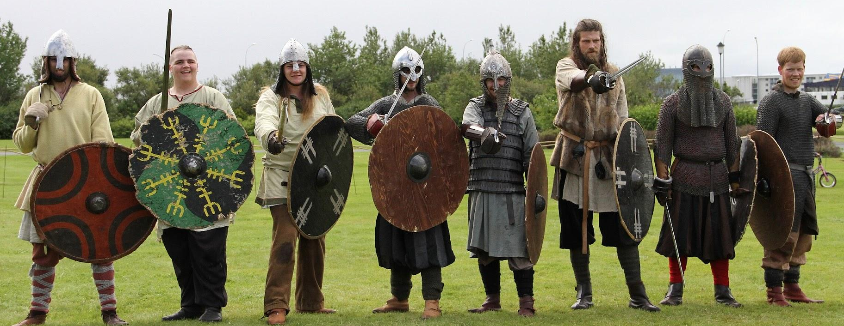
Class Curriculum Information
CLASS NOTICES
Class Text
Our class text ‘Cosmic’ by Frank Cottrell Boyce.
Reading
All children will read for at least 10 minutes every day in school and we hope parents will do the same at home. Children will bring a reading record home so they can track their reading and share this with you. We would appreciate it if you could sign this off each week and talk to your child about what they are reading.
PE
PE will take place on a Tuesday and Thursday. Children can come to school in their kit (jogging bottoms/PE shorts/leggings and t-shirt/jumper with trainers) on PE days.
Homework
Homework will be sent out every Thursday with it returning back into school by the following Tuesday. If you have any questions about the homework, please come and talk to us. Each week your child will be given a set of spellings to practice at home.
Please ensure your child brings in a named water bottle everyday.
Year 5
Autumn Term 1
2025/2026
The Anglo Saxons and Vikings

Slide 2



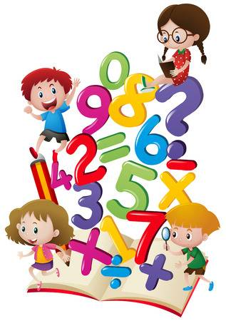

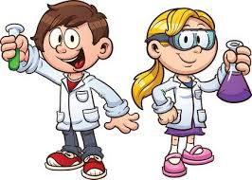
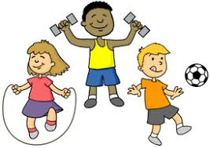

ENRICHMENT AREAS OF LEARNING
ENRICHMENT AREAS OF LEARNING
English | In English this term we will be focusing on inference and retrieval skills in reading. In writing, we will be focusing integrating dialogue with character description. Then we will move onto using persuasive language to write a holiday leaflet for Scandinavia.
Maths | In Maths, we will be learning about place value. We will look at Roman numerals up to 1000. We will read, write and partition numbers up to 1000000, as well as comparing and ordering them. We will round numbers to the nearest 10, 100 or 1000.
Science | We will be learning about Space and the universe. We will carry out some investigations to help us understand the difference between day and night and sundials.
Computing | This half-term we will be developing our understanding of computer systems and how information is transferred between systems and devices. We will also develop our skills in working together online.
Geography and History | We will learn about the Viking invasion and the impact of the Viking raids on Anglo Saxon England. We will learn about the Viking way of life and why they lived the way they did.
R.E. | This term we will be focusing on the key question ‘What does it mean to be a Muslim in Britain today?’. We will explore the five pillars of Islam and the importance of these to Muslim believers.
D.T/ Art | In DT we will look at moving levers, sliders and pop ups. We will design and build a moving book for a younger child. We will read these to Year 1 pupils and assess the effectiveness of our moving books.
P.E. | Our PE will focus on hockey and football. We will look at components such as speed, stamina, strength, coordination, balance and agility. We will be beginning to develop consistency and control in dribbling, passing and receiving a ball.

