Slide 1


Year 5 – Spring Block 2 – Fractions
Step 2: Improper Fractions to Mixed Numbers
© Classroom Secrets Limited 2019

Slide 2
Improper Fractions
A fraction in which the numerator is greater than the denominator.
They are BIG HEADED!!
8
=
4

Slide 3
Mixed Numbers
A mixed number has a part that is a whole and a part that is a fraction.
They’re a bit mixed up!
1
3
=
4

Slide 4
CHANGE:
An Improper Fraction to a Mixed Number
  4
  1
1
PAIRS:
Can you change this improper fraction?
=
3
3
Use a Diagram to help you!!
How many wholes? And how many parts are left over?

Slide 5
Problem Solving 1
Use the number cards to show an improper fraction as a mixed number.
1
3
7
1
6
7
=
© Classroom Secrets Limited 2019

Slide 6
Problem Solving 1
Use the number cards to show an improper fraction as a mixed number.
1
3
7
1
6
7
1
3
6
1
=
7
7
© Classroom Secrets Limited 2019

Slide 7
Reasoning 1
Find and correct the mistakes. Explain your answer.
a. | 19 |  | = |  | 2 | 1
 | 9 |  |  |  |  | 9
b. | 24 |  | = |  | 3 | 4
 | 7 |  |  |  |  | 7
c. | 31 |  | = |  | 3 | 8
 | 8 |  |  |  |  | 7
d. | 24 |  | = |  | 2 | 4
 | 10 |  |  |  |  | 10
© Classroom Secrets Limited 2019

Slide 8
Reasoning 1
Find and correct the mistakes. Explain your answer.
B – the numerator should be 3.
C – the numerator and denominator have been mixed up.
a. | 19 |  | = |  | 2 | 1
 | 9 |  |  |  |  | 9
b. | 24 |  | = |  | 3 | 3
 | 7 |  |  |  |  | 7
c. | 31 |  | = |  | 3 | 7
 | 8 |  |  |  |  | 8
d. | 24 |  | = |  | 2 | 4
 | 10 |  |  |  |  | 10
© Classroom Secrets Limited 2019

Slide 9
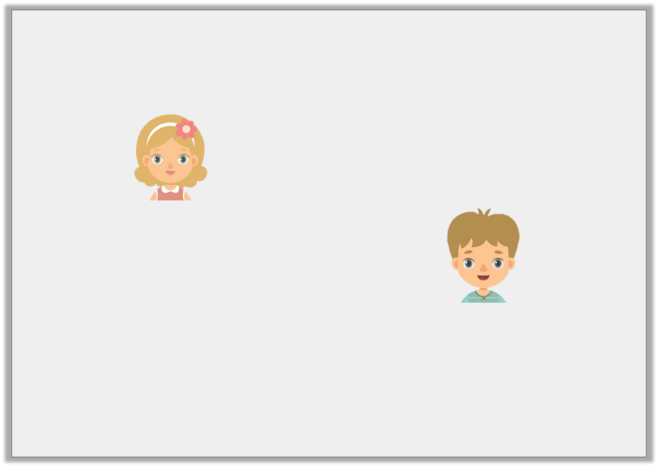
Reasoning 2
Four pizzas are bought for a party. They are cut into 6 equal slices. At the end of the party, there are 9 slices of pizza left.
Who is correct? Prove it.
There is left.
1 | 3
 | 6
Jane
There is left.
1 | 9
 | 6
Tom
© Classroom Secrets Limited 2019

Slide 10
Reasoning 2
Four pizzas are bought for a party. They are cut into 6 equal slices. At the end of the party, there are 9 slices of pizza left.
Who is correct? Prove it.
Jane is correct because there is of the pizza left which, as a mixed number, is 1 .
There is left.
1 | 3
 | 6
Jane
There is left.
1 | 9
 | 6
Tom
9
6
3
6
© Classroom Secrets Limited 2019

Slide 11

This was the pizza left over at a party.
Each pizza was cut equally.
Anna said, “If you add the 11/5
we ate to this, then there were 5 whole pizzas to begin with.”
Do you agree? Explain why.

Slide 12

Three children have converted into an improper fraction.
Can you explain the misconception each child has and what they need to do differently?

